Slide 1

Karthi M (2021503514)
Department of Computer Technology
Madras Institute of Technology
Anna University, Zone - IV
Final Project
3/21/2024 Annual Review

Slide 2
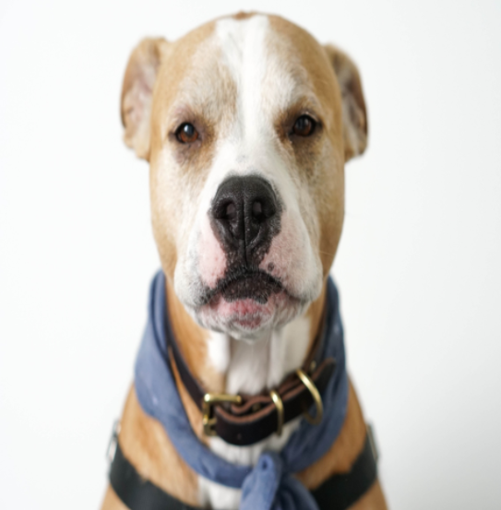
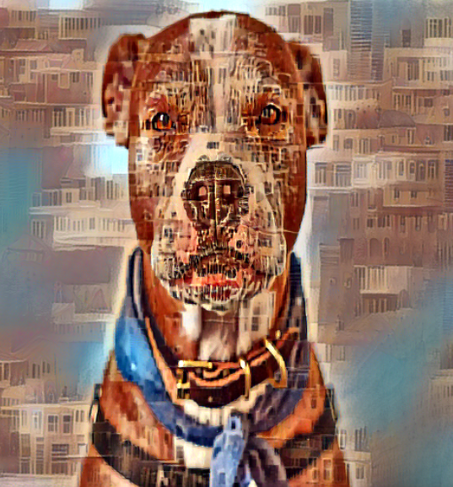
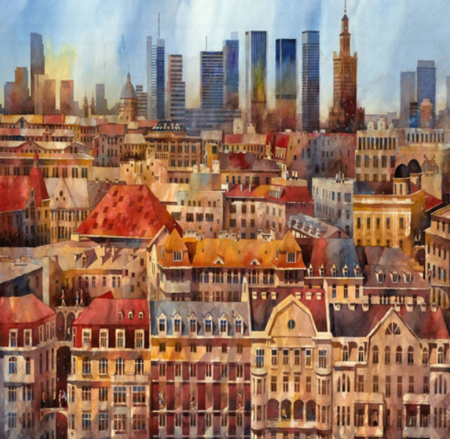

PROJECT TITLE
Style Transfer using CNN
CNN
3/21/2024 Annual Review

Slide 3


AGENDA
In this project, we have embarked on the development of an intuitive and interactive neural style transfer application, aiming to empower users to explore the artistic possibilities inherent in blending the content of one image with the style of another. Our objectives have been carefully crafted to ensure that the application not only facilitates seamless image selection from various sources but also offers customizable hyperparameters for fine-tuning artistic output according to user preferences.
Leveraging available computational resources, we have implemented intelligent resource allocation mechanisms to optimize processing efficiency, whether utilizing GPU or CPU. Balancing computational speed and output quality has been a focal point, with strategies implemented to strike an equilibrium between the two. Furthermore, our endeavor extends beyond technical intricacies; we aspire to democratize the realm of artistic expression by making neural style transfer accessible to a wider audience through a user-friendly interface. As we progress, rigorous evaluation and testing will validate the application's performance and efficiency, paving the way for deployment and future enhancements to enrich the user experience further.
3/21/2024 Annual Review

Slide 4

PROBLEM STATEMENT
The project aims to develop an intuitive and interactive application for neural style transfer, enabling users to effortlessly blend content and style images from diverse sources. Leveraging computational resources, the application intelligently allocates tasks to GPU or CPU for efficient execution. Key features include customizable hyperparameters, real-time visualization, and seamless user experience. By addressing resource management challenges, the application aims to balance speed and quality, democratizing artistic creation. Deliverables include a fully functional application with comprehensive documentation. Evaluation and testing will demonstrate performance across varied scenarios and input images.
3/21/2024 Annual Review

Slide 5
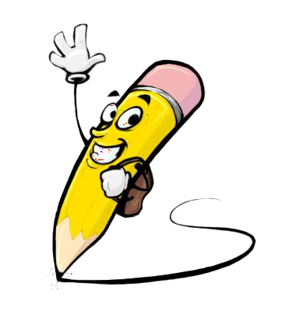
PROJECT OVERVIEW
The project entails creating an intuitive and interactive application for neural style transfer, employing Convolutional Neural Networks (CNNs) to effectively manipulate image features. Users will have the ability to effortlessly select content and style images from diverse sources, with the application intelligently allocating processing tasks to GPU or CPU for efficient execution. Key features include customizable hyperparameters and real-time visualization capabilities, enhancing user experience. Resource management challenges will be addressed to strike a balance between computational speed and output quality. Through rigorous evaluation and testing, the project aims to demonstrate the application's performance and efficiency across various scenarios and input images.
3/21/2024 Annual Review

Slide 6

WHO ARE THE END USERS?
1. Artists and Designers: Individuals seeking to experiment with different artistic styles and create visually captivating artwork.
2. Photographers: Professionals or hobbyists looking to apply artistic styles to their photographs to enhance their visual appeal.
3. Content Creators: Those interested in generating unique and eye-catching visuals for digital content, such as social media posts, websites, and presentations.
4. Educators and Students: Teachers and students in art and design fields who wish to explore and learn about neural style transfer techniques.
5. Creative Professionals: Professionals working in advertising, marketing, and multimedia production who require innovative visual content for their projects.
6. General Users: Anyone interested in exploring the intersection of art and technology, regardless of their level of expertise in either field.
These end users span various industries and sectors, highlighting the potential widespread application of the neural style transfer system.
3/21/2024 Annual Review

Slide 7
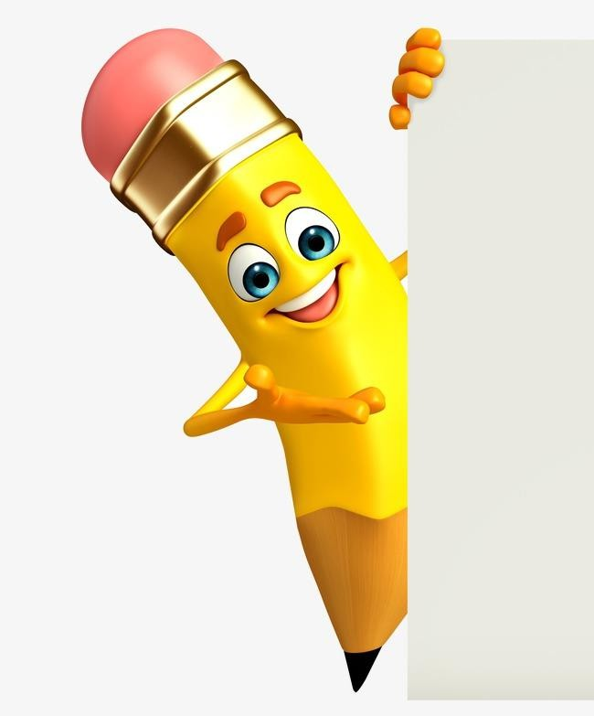
YOUR SOLUTION AND ITS VALUE PROPOSITION
Solution:
Our solution, an intuitive and interactive neural style transfer application, offers users the unprecedented ability to effortlessly blend the content of one image with the style of another, resulting in visually captivating artwork. By leveraging Convolutional Neural Networks (CNNs) and advanced deep learning techniques, our application ensures effective manipulation of image features, enabling users to explore a myriad of artistic possibilities..
3/21/2024 Annual Review

Slide 8
YOUR SOLUTION AND ITS VALUE PROPOSITION
Value Proposition:
Our application's value proposition lies in its ability to empower users to effortlessly create visually captivating artwork through neural style transfer. By offering a user-friendly interface, flexible image selection, real-time visualization, and efficient processing, we enhance the artistic experience. Customizable parameters ensure tailored results, while optimized resource utilization balances speed and quality. Ultimately, our solution democratizes artistic expression, making neural style transfer accessible to a wider audience and delivering tangible value through creativity and innovation.
3/21/2024 Annual Review

Slide 9

THE WOW IN YOUR SOLUTION
1. Seamless Blending: Our application seamlessly blends the content of one image with the style of another, creating visually stunning artwork with just a few clicks.
2. Real-time Visualization: Users can witness the style transfer process in real-time, providing immediate feedback and enabling iterative refinement of their creations.
3. Flexible Image Selection: With the ability to select content and style images from various sources, including URLs and local uploads, users have unparalleled freedom in their artistic exploration.
4. Customizable Parameters: Our application offers customizable hyperparameters such as iteration count, image dimensions, and loss weights, allowing users to fine-tune their artistic output according to their preferences.
5.Efficient Processing: Leveraging advanced deep learning techniques and optimized resource utilization, our solution ensures efficient execution of style transfer operations, delivering high-quality results in a timely manner.
6. User-Centric Design: Designed with the user in mind, our application features an intuitive interface and comprehensive feature set, catering to the needs of artists, photographers, content creators, educators, and general users alike.
7. Democratizing Artistic Expression: By making neural style transfer accessible to a wider audience and simplifying the creation of visually captivating artwork, our solution democratizes artistic expression, inspiring creativity and innovation.
3/21/2024 Annual Review

Slide 10
MODELLING
The project utilizes several frameworks and libraries for various tasks in deep learning and data preprocessing. Here's a list of frameworks and libraries used:
1. TensorFlow: TensorFlow is a powerful open-source machine learning library developed by Google. It's widely used for building and training deep learning models, including convolutional neural networks (CNNs) for image classification.
2. Keras: Keras is a high-level neural networks API written in Python and compatible with TensorFlow. It provides a user-friendly interface for building and training deep learning models, making it easier to prototype and experiment with different architectures.
3. NumPy: NumPy is a fundamental package for scientific computing with Python. It provides support for multi-dimensional arrays and matrices, along with a collection of mathematical functions to operate on these arrays, making it essential for data manipulation and numerical computations.
3/21/2024 Annual Review

Slide 11
MODELLING
4. Pandas: Pandas is a fast, powerful, and flexible open-source data analysis and manipulation library built on top of NumPy. It provides data structures like DataFrame for handling structured data and tools for data cleaning, reshaping, and analysis.
5. Matplotlib: Matplotlib is a comprehensive library for creating static, animated, and interactive visualizations in Python. It's commonly used for plotting graphs, histograms, scatter plots, etc., to visualize data and model performance.
6. Plotly Express: Plotly Express is a high-level interface for creating expressive and interactive visualizations using Plotly. It provides easy-to-use functions for generating various types of plots, including pie charts, line plots, scatter plots, etc.
7. SciPy: SciPy is a library used for scientific and technical computing in Python. It provides modules for optimization, integration, interpolation, linear algebra, and more, making it useful for various numerical computations and statistical analysis.
These frameworks and libraries collectively provide a robust ecosystem for building, training, and analyzing deep learning models for image classification tasks.

Slide 12
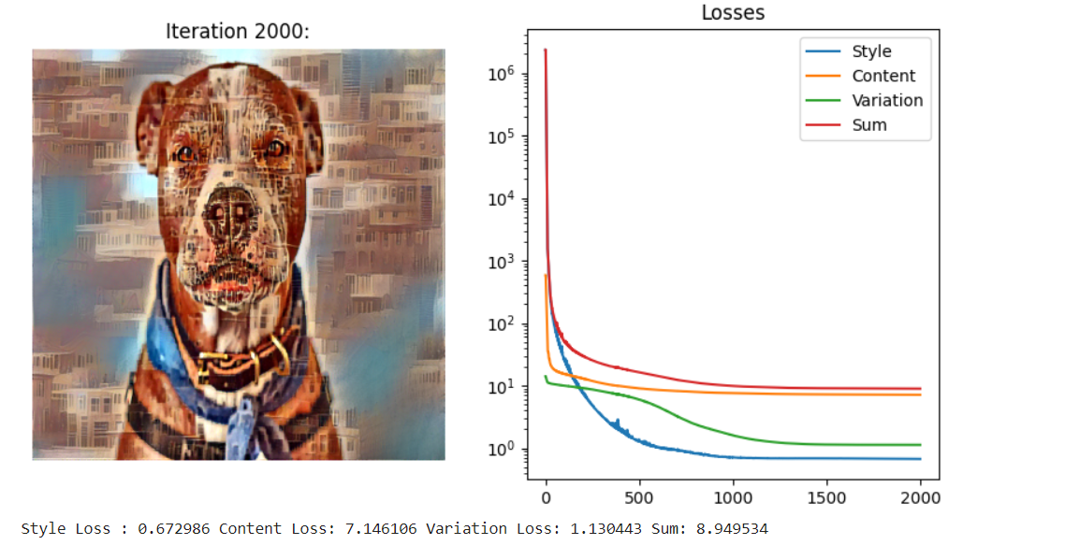
RESULTS
3/21/2024 Annual Review

Slide 13
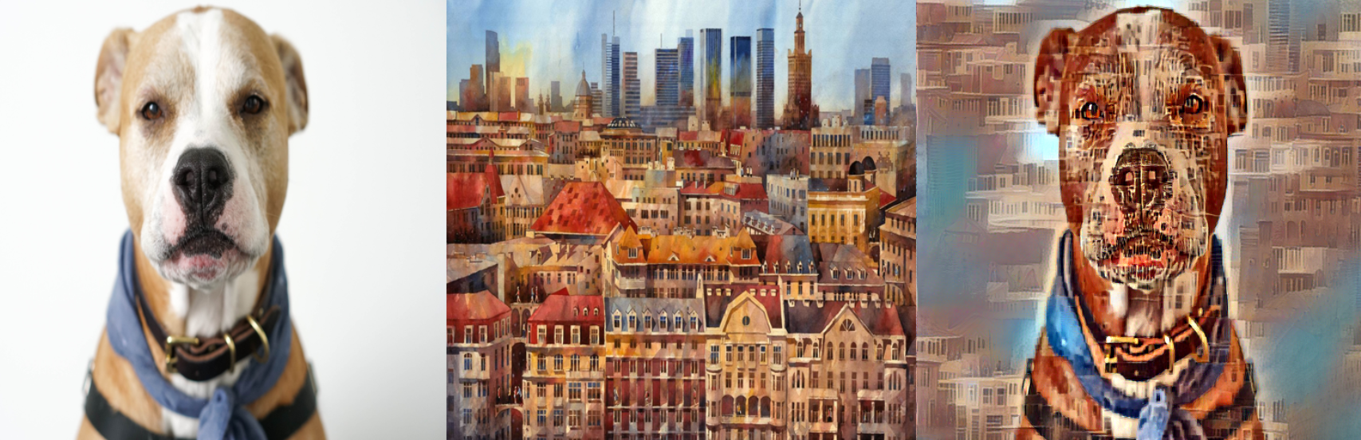
RESULTS
3/21/2024 Annual Review

Slide 14
Thank you!

